Slide 1
1. Vulnerability Assessment on testphp.vulnweb.com Website

Slide 2
Document Details
Document Title | Web Application Vulnerability Assessment
Target Machine/Website | testphp.vulnweb.com
Submission Date | 07-07-2021
Submitted to | Sir. Varun Pathak
Designation | Major Project on Cyber Security
Documented by | Daniel Giftson E
E-mail | daniel.giftson@iitgn.ac.in
Contact No. | 9150471860

Slide 3
High – level Summary of Testing Overview of the Vulnerability Assessment

Slide 4
Vulnerability Assessment - Overview
Background:
I performed an automatic vulnerability scanning test on this website (testphp.vulnweb.com) using Nessus as well as found out vulnerabilities manually.
I ranked the vulnerabilities according to the threat level on the Severity Base of CVSS v3.0.
I have also recommended solutions for the vulnerabilities identified.
I, therefore, have communicated all the results and outputs through this report.
Result:
During assessment, I found the website related vulnerabilities and insecure practices were there on the website, testphp.vulnweb.com.
Critical Security flaws have been noted in this website.

Slide 5
Risk Definition
Critical | Severe weakness in controls that represent exposure to the organization or risks that could seriously compromise the control framework, data integrity and operational efficiency. These risks need to be addressed first.
High | Weakness in controls that represent exposure to the organization or risks that could seriously compromise the control framework, data integrity and operational efficiency. These risks need to be addressed with utmost priority.
Medium | Potential weakness in controls, which could develop into an exposure. Or issues that represent areas of concern and may impact controls. They should be addressed reasonably promptly.
Low | Potential weakness in controls, which in combination with other weakness can develop into exposure. Suggested improvements not immediately / directly affecting controls.
None/Info | Minor vulnerabilities or can be the information about a system or website.

Slide 6
Vulnerability Statics
Risk Factor | No. of Vulnerabilities
Critical | 1
High | 13
Medium | 15
Low | 1
Info | 20

Slide 7
1. PHP Unsupported Version Detection
Observation:
The remote host contains an unsupported version of a web application scripting language.
According to its version, the installation of PHP on the remote host is no longer supported. Lack of support implies that no new security patches for the product will be released by the vendor. As a result, it is likely to contain security vulnerabilities.
Recommendation:
Upgrade to a version of PHP that is currently supported.
Risk: |  | Critical |  | High |  | Medium |  | Low |  | Info

Slide 8
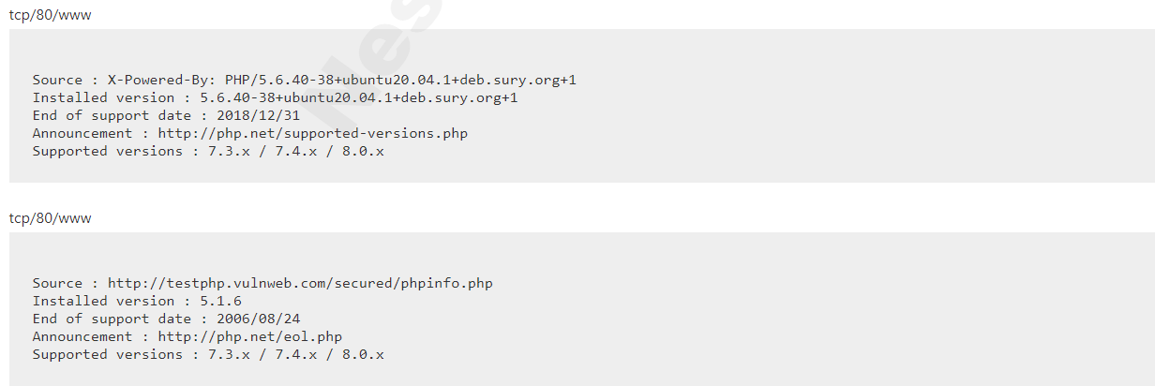
Vulnerability Detection Result:

Slide 9
2. CGI Generic SQL Injection
Observation:
A web application is potentially vulnerable to SQL injection.
By providing specially crafted parameters to CGIs, Nessus was able to get an error from the underlying database. This error suggests that the CGI is affected by a SQL injection vulnerability.
An attacker may exploit this flaw to bypass authentication, read confidential data, modify the remote database, or even take control of the remote operating system.
Recommendation:
Modify the relevant CGIs so that they properly escape arguments.
Risk: |  | Critical |  | High |  | Medium |  | Low |  | Info

Slide 10
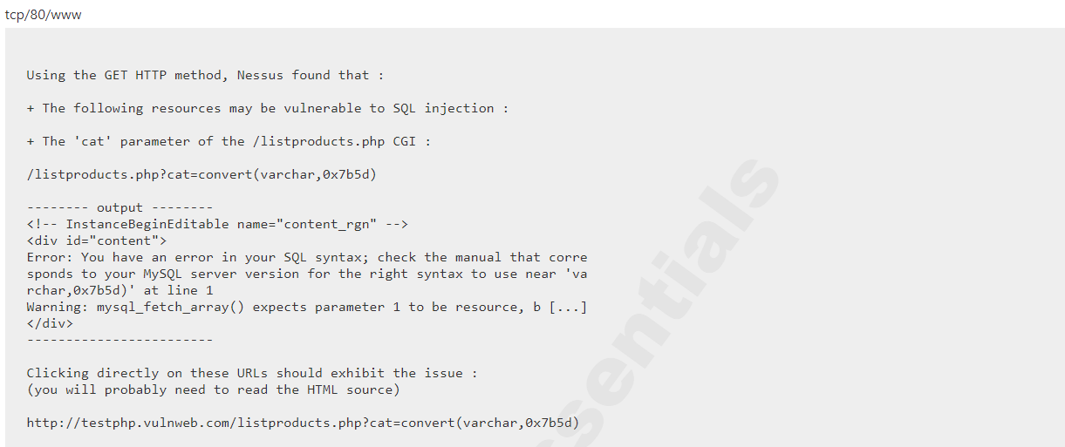
Vulnerability Detection Result:

Slide 11
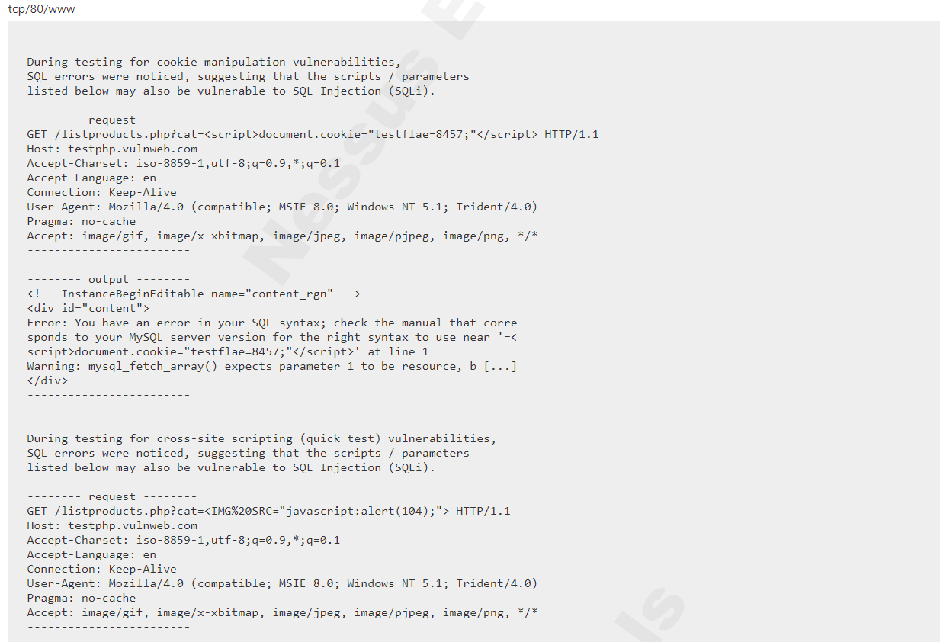
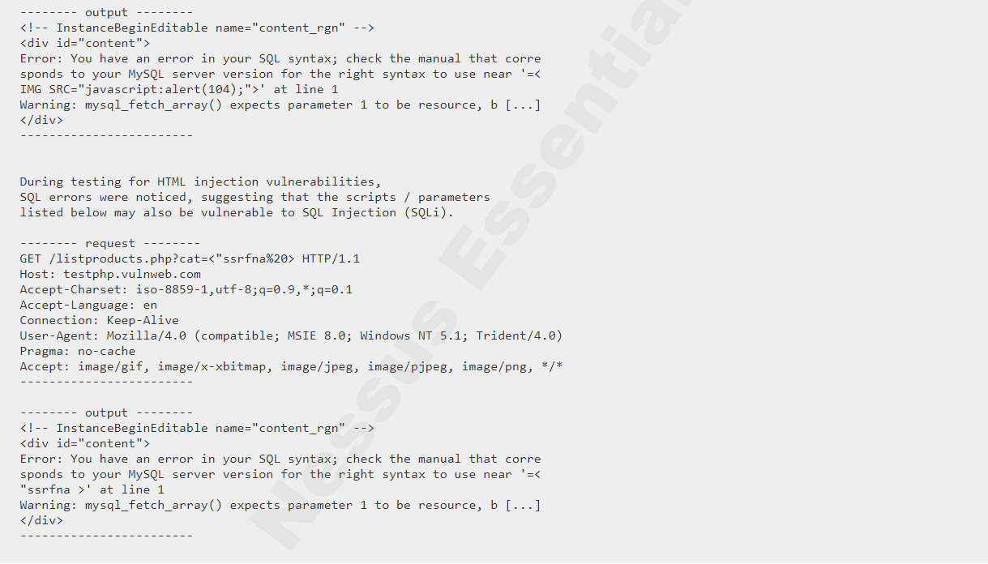
Vulnerability Detection Result: (2nd Pass)

Slide 12
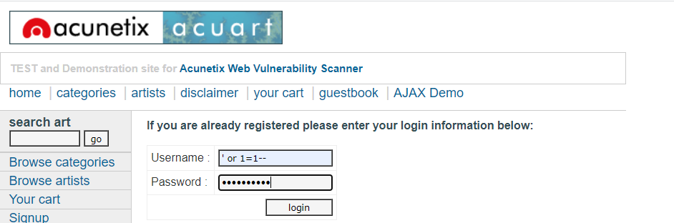
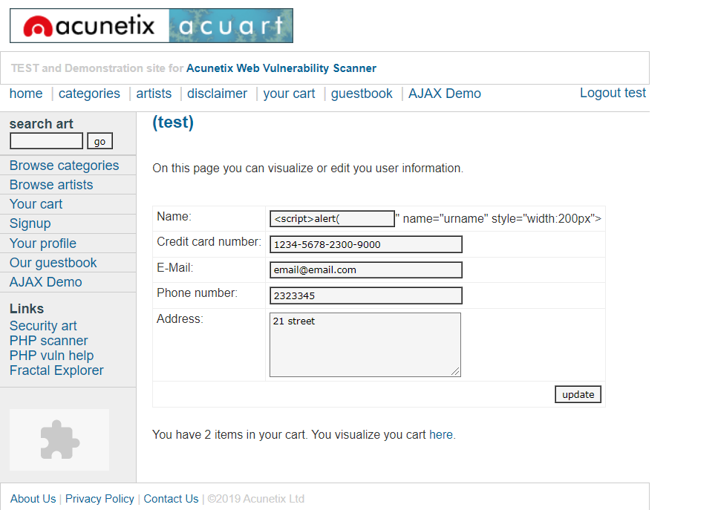
Vulnerability Detection Result (Manually):
Binary SQL Injection – Bypassing Authentication

Slide 13
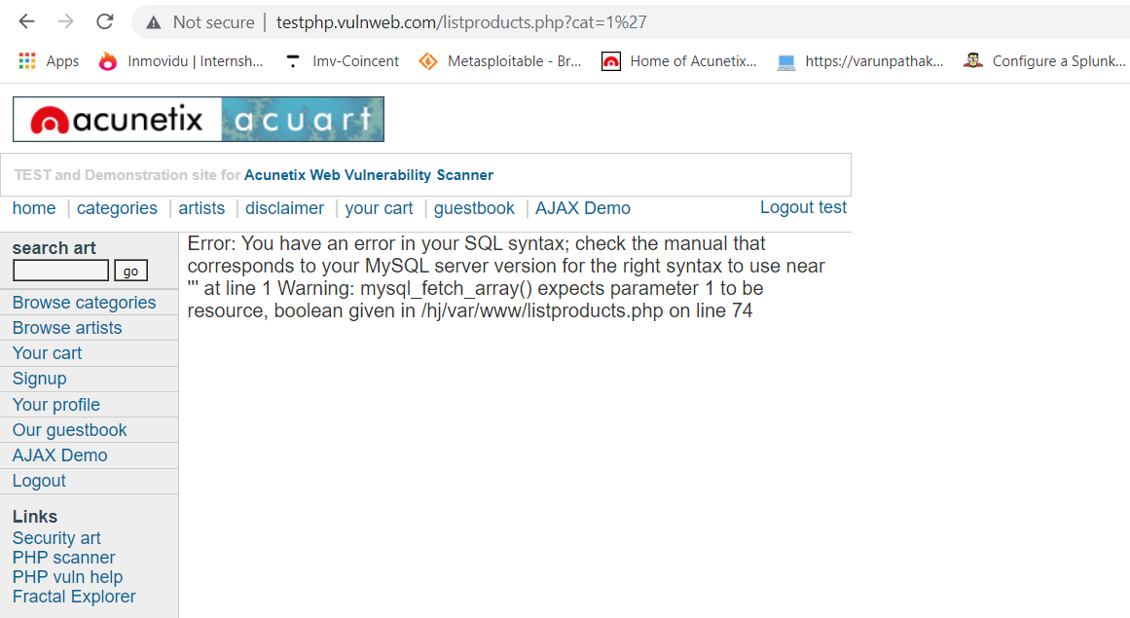
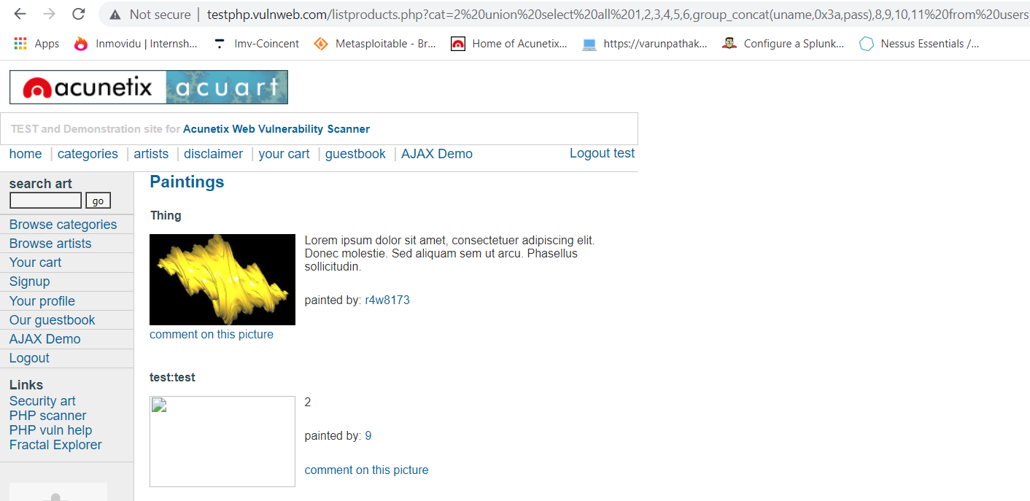
Union-based SQL Injection – Fetching Data from Database

Slide 14
3. CGI Generic SQL Injection (blind)
Observation:
A CGI application hosted on the remote web server is potentially prone to SQL injection attack.
By sending specially crafted parameters to one or more CGI scripts hosted on the remote web server, Nessus was able to get a very different response, which suggests that it may have been able to modify the behavior of the application and directly access the underlying database.
An attacker may be able to exploit this issue to bypass authentication, read confidential data, modify the remote database, or even take control of the remote operating system.
Recommendation:
Modify the affected CGI scripts so that they properly escape arguments.

Slide 15
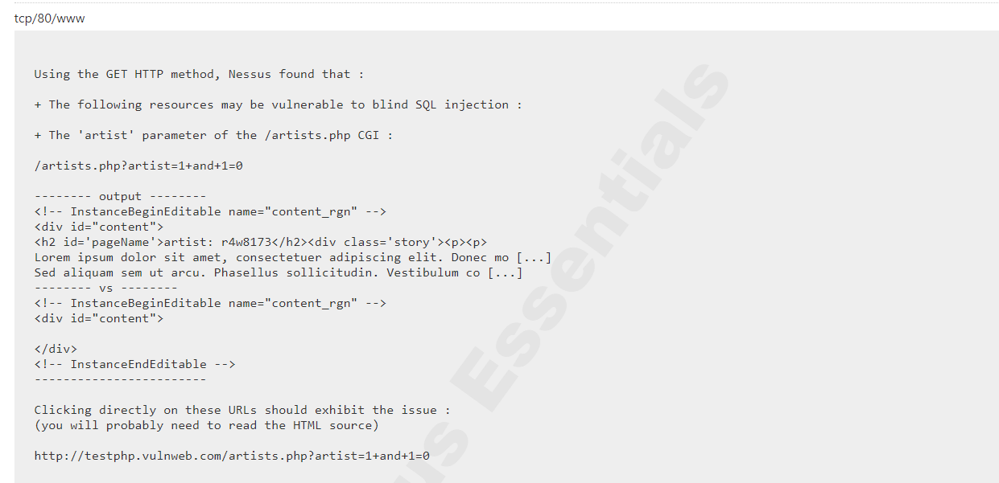
Vulnerability Detection Result:

Slide 16
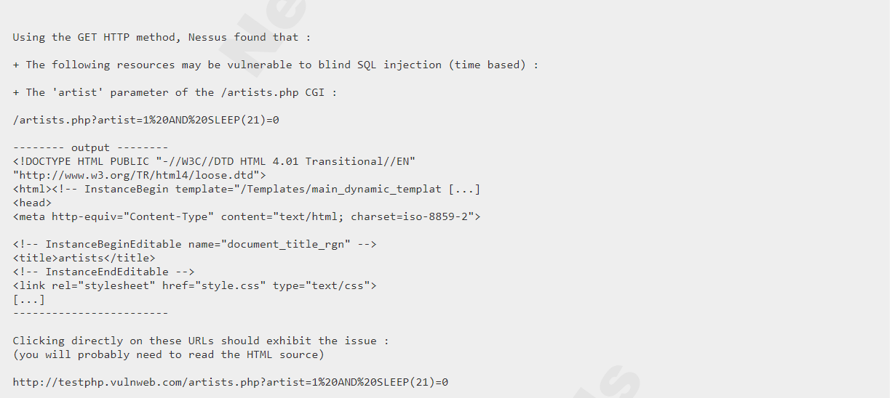
Vulnerability Detection Result: (Time-Based)

Slide 17
4. PHP 5 < 5.2.7 Multiple Vulnerabilities
Observation:
The remote web server uses a version of PHP that is affected by multiple vulnerabilities
According to its banner, the version of PHP installed on the remote host is prior to 5.2.7. It is, therefore, affected by multiple vulnerabilities :
- There is a buffer overflow flaw in the bundled PCRE library that allows a denial-of-service attack.
(CVE-2008-2371)
- Multiple directory traversal vulnerabilities exist in functions such as 'posix_access', 'chdir', and 'ftok'
that allow a remote attacker to bypass 'safe_mode'
restrictions. (CVE-2008-2665 and CVE-2008-2666).

Slide 18
- A buffer overflow flaw in 'php_imap.c' may be triggered when processing long message headers due to the use of obsolete API calls. This can be exploited to cause a denial of service or to execute arbitrary code. (CVE-2008-2829) - A buffer overflow in the 'imageloadfont' function in 'ext/gd/gd.c' can be triggered when a specially crafted font is given. This can be exploited to cause a denial of service or to execute arbitrary code. (CVE-2008-3658) - A buffer overflow flaw exists in PHP's internal function 'memnstr' which can be exploited by an attacker using the delimiter argument to the 'explode' function. This can be used to cause a denial of service or to execute arbitrary code. (CVE-2008-3659) - When PHP is used as a FastCGI module, an attacker by requesting a file whose file name extension is preceded by multiple dots can cause a denial of service. (CVE-2008-3660) - A heap-based buffer overflow flaw in the mbstring extension can be triggered via a specially crafted string containing an HTML entity that is not handled during Unicode conversion. This can be exploited to execute arbitrary code.(CVE-2008-5557) - Improper initialization of global variables 'page_uid' and 'page_gid' when PHP is used as an Apache module allows the bypassing of security restriction due to SAPI 'php_getuid' function overloading. (CVE-2008-5624) - PHP does not enforce the correct restrictions when 'safe_mode' is enabled through a 'php_admin_flag' setting in 'httpd.conf'. This allows an attacker, by placing a specially crafted 'php_value' entry in '.htaccess', to able to write to arbitrary files. (CVE-2008-5625)

Slide 19
- The 'ZipArchive::extractTo' function in the ZipArchive extension fails to filter directory traversal sequences from file names. An attacker can exploit this to write to arbitrary files. (CVE-2008-5658) - Under limited circumstances, an attacker can cause a file truncation to occur when calling the 'dba_replace' function with an invalid argument. (CVE-2008-7068) - A buffer overflow error exists in the function 'date_from_ISO8601' function within file 'xmlrpc.c' because user-supplied input is improperly validated. This can be exploited by a remote attacker to cause a denial of service or to execute arbitrary code. (CVE-2014-8626) Recommendation: Upgrade to PHP version 5.2.8 or later. Note that version 5.2.7 has been removed from distribution because of a regression in that version that results in the 'magic_quotes_gpc' setting remaining off even if it was set to on.

Slide 20
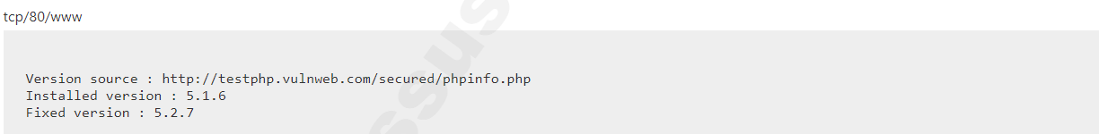
Vulnerability Detection Result:

Slide 21
5. PHP 5.x < 5.2 Multiple Vulnerabilities
Observation:
The remote web server uses a version of PHP that is affected by multiple buffer overflows.
According to its banner, the version of PHP 5.x installed on the remote host is older than 5.2. Such versions may be affected by several buffer overflows.
To exploit these issues, an attacker would need the ability to upload an arbitrary PHP script on the remote server or to manipulate several variables processed by some PHP functions such as 'htmlentities().’
Recommendation:
Upgrade to PHP version 5.2.0 or later.

Slide 22
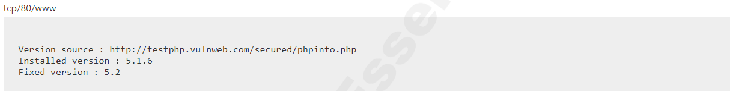
Vulnerability Detection Result:

Slide 23
6. PHP 5.x < 5.2.2 Multiple Vulnerabilities
Observation:
The remote web server uses a version of PHP that is affected by multiple vulnerabilities.
According to its banner, the version of PHP 5.x installed on the remote host is older than 5.2.2. It is, therefore, affected by multiple vulnerabilities:
- A heap-based buffer overflow vulnerability was found in PHP's gd extension. A script that could be forced to process WBMP images from an untrusted source could result in arbitrary code execution. (CVE-2007-1001)
- A vulnerability in the way the mbstring extension setglobal variables was discovered where a script using the mb_parse_str() function to set global variables could be forced to to enable the register_globals configuration option, possibly resulting in global variable injection. (CVE-2007-1583)
- A context-dependent attacker could read portions of heap memory by executing certain scripts with a serialized data input string beginning with 'S:', which did not properly track the number of input bytes being processed. (CVE-2007-1649)
- A vulnerability in how PHP's mail() function processed email messages, truncating potentially important information after the first ASCIIZ (\0) byte. (CVE-2007-1717)

Slide 24
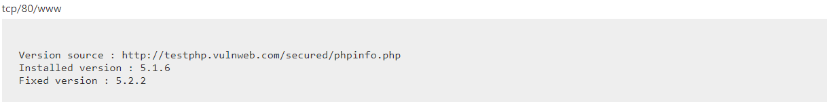
- A vulnerability in how PHP's mail() function processed header data was discovered. If a script sent mail using a subject header containing a string from an untrusted source, a remote attacker could send bulk email to unintended recipients (CVE-2007-1718). Recommendation: Upgrade to PHP version 5.2.2 or later. Vulnerability Detection Result:

Slide 25
7. PHP < 5.2.1 Multiple Vulnerabilities
Observation:
The remote web server uses a version of PHP that is affected by multiple flaws.
According to its banner, the version of PHP installed on the remote host is older than 5.2.1. Such versions may be affected by several issues, including buffer overflows, format string vulnerabilities, arbitrary code execution, 'safe_mode' and 'open_basedir' bypasses, and clobbering of super-globals.
Recommendation:
Upgrade to PHP version 5.2.1 or later.

Slide 26
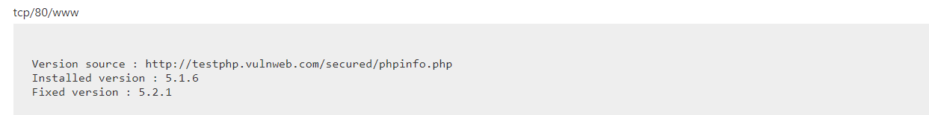
Vulnerability Detection Result:

Slide 27
8. PHP < 5.2.11 Multiple Vulnerabilities
Observation:
The remote web server uses a version of PHP that is affected by multiple flaws.
According to its banner, the version of PHP installed on the remote host is older than 5.2.11. Such versions may be affected by several security issues :
An unspecified error occurs in certificate validation inside 'php_openssl_apply_verification_policy’.
- An unspecified input validation vulnerability affects the color index in 'imagecolortransparent()'.
- An unspecified input validation vulnerability affects exif processing.
Calling 'popen()' with an invalid mode can cause a crash under Windows. (Bug #44683)
An integer overflow in 'xml_utf8_decode()' can make it easier to bypass cross-site scripting and SQL injection protection mechanisms using a specially crafted string with a long UTF-8 encoding. (Bug #49687)
- 'proc_open()' can bypass 'safe_mode_protected_env_vars’. (Bug #49026)

Slide 28

Recommendation: Upgrade to PHP version 5.2.11 or later. Vulnerability Detection Result:

Slide 29
9. PHP < 5.2.3 Multiple Vulnerabilities
Observation:
The remote web server uses a version of PHP that is affected by multiple flaws.
According to its banner, the version of PHP installed on the remote host is older than 5.2.3. It is, therefore, affected by multiple vulnerabilities:
- A buffer overflow in the sqlite_decode_function() in the bundled sqlite library could allow context-dependent attackers to execute arbitrary code. (CVE-2007-1887)
- A CRLF injection vulnerability in the FILTER_VALIDATE_EMAIL filter could allow an attacker to inject arbitrary email headers via a special email address. This only affects Mandriva Linux 2007.1. (CVE-2007-1900)
- An infinite-loop flaw was discovered in the PHP gd extension. A script that could be forced to process PNG images from an untrusted source could allow a remote attacker to cause a denial of service. (CVE-2007-2756)
- An integer overflow flaw was found in the chunk_split() function that ould possibly execute arbitrary code as the apache user if a remote attacker was able to pass arbitrary data to the third argument of chunk_split() (CVE-2007-2872).
- An open_basedir and safe_mode restriction bypass which could allow context-dependent attackers to determine the existence of arbitrary files. (CVE-2007-3007)

Slide 30
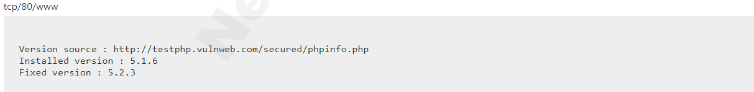
Recommendation: Upgrade to PHP version 5.2.3 or later. Vulnerability Detection Result:

Slide 31
10. PHP < 5.2.6 Multiple Vulnerabilities
Observation:
The remote web server uses a version of PHP that is affected by multiple flaws.
According to its banner, the version of PHP installed on the remote host is older than 5.2.6. Such versions may be affected by the following issues :
- A stack-based buffer overflow in FastCGI SAPI.
- An integer overflow in printf().
- An security issue arising from improper calculation of the length of PATH_TRANSLATED in cgi_main.c.
- A safe_mode bypass in cURL.
- Incomplete handling of multibyte chars inside escapeshellcmd().
- Issues in the bundled PCRE fixed by version 7.6.

Slide 32
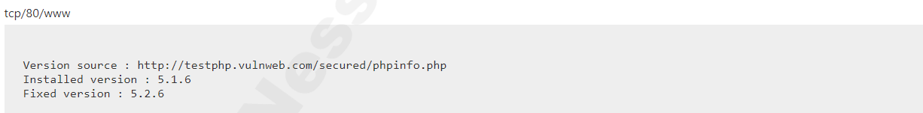
Recommendation: Upgrade to PHP version 5.2.6 or later. Vulnerability Detection Result:

Slide 33
11. PHP < 5.2.8 Multiple Vulnerabilities
Observation:
The remote web server uses a version of PHP that may be affected by multiple vulnerabilities.
According to its banner, the version of PHP installed on the remote host is earlier than 5.2.8. As such, it is potentially affected by the following vulnerabilities :
- PHP fails to properly sanitize error messages of arbitrary HTML or script code, would code allow for cross-site scripting attacks if PHP's 'display_errors' setting is enabled. (CVE-2008-5814)
- Version 5.2.7 introduced a regression with regard to 'magic_quotes' functionality due to an incorrect fix to the filter extension. As a result, the 'magic_quotes_gpc' setting remains off even if it is set to on. (CVE-2008-5844)
Recommendation:
Upgrade to PHP version 5.2.8 or later.

Slide 34
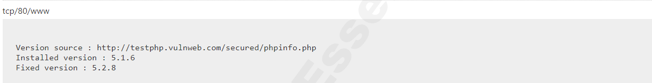
Vulnerability Detection Result:

Slide 35
12. PHP < 5.3.12 / 5.4.2 CGI Query String Code Execution
Observation:
The remote web server uses a version of PHP that is affected by a remote code execution vulnerability.
According to its banner, the version of PHP installed on the remote host is earlier than 5.3.12 / 5.4.2, and as such is potentially affected by a remote code execution and information disclosure vulnerability.
An error in the file 'sapi/cgi/cgi_main.c' can allow a remote attacker to obtain PHP source code from the web server or to potentially execute arbitrary code. In vulnerable configurations, PHP treats certain query string parameters as command line arguments including switches such as '-s', '-d', and '-c'.
Recommendation:
Upgrade to PHP version 5.3.12 / 5.4.2 or later. A 'mod_rewrite’ workaround is available as well.

Slide 36
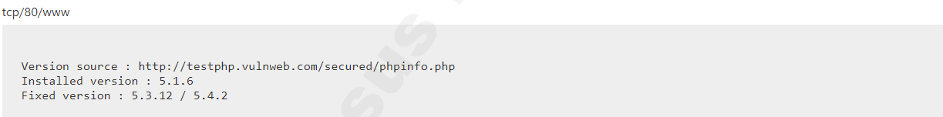
Vulnerability Detection Result:

Slide 37
13. PHP 5.x < 5.2.2 Multiple Vulnerabilities
Observation:
The remote web server uses a version of PHP that is affected by multiple flaws.
According to its banner, the version of PHP installed on the remote host is older than 5.3.9. As such, it may be affected by the following security issues :
- The 'is_a()' function in PHP 5.3.7 and 5.3.8 triggers a call to '__autoload()'. (CVE-2011-3379)
- It is possible to create a denial-of-service condition by sending multiple, specially crafted requests containing parameter values that cause hash collisions when computing the hash values for storage in a hash table. (CVE-2011-4885)
- An integer overflow exists in the exif_process_IFD_TAG function in exif.c that can allow a remote attacker to read arbitrary memory locations or cause a denial-of-service condition. This vulnerability only affects PHP 5.4.0beta2 on 32-bit platforms. (CVE-2011-4566)

Slide 38
- Calls to libxslt are not restricted via xsltSetSecurityPrefs(), which could allow an attacker to create or overwrite files, resulting in arbitrary code execution. (CVE-2012-0057) - An error exists in the function 'tidy_diagnose' that can allow an attacker to cause the application to dereference a NULL pointer. This causes the application to crash. (CVE-2012-0781) - The 'PDORow' implementation contains an error that can cause application crashes when interacting with the session feature. (CVE-2012-0788) - An error exists in the timezone handling such that repeated calls to the function 'strtotime' can allow a denial-of-service attack via memory consumption. (CVE-2012-0789) Recommendation: Upgrade to PHP version 5.3.9 or later.

Slide 39

Vulnerability Detection Result:

Slide 40
14. PHP 5.x < 7.3.24 Multiple Vulnerabilities
Observation:
The version of PHP running on the remote web server is affected by multiple vulnerabilities.
According to its self-reported version number, the version of PHP running on the remote web server is prior to 7.3.24. It is, therefore affected by multiple vulnerabilities
Recommendation:
Upgrade to PHP version 7.3.24 or later.

Slide 41
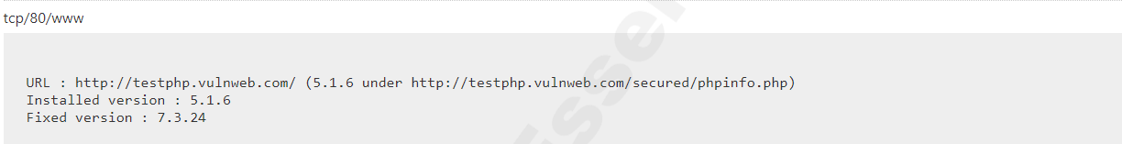
Vulnerability Detection Result:

Slide 42
15. Browsable Web Directories
Observation:
Some directories on the remote web server are browsable.
Multiple Nessus plugins identified directories on the web server that are browsable.
Recommendation:
Make sure that browsable directories do not leak confidential information or give access to sensitive
resources. Additionally, use access restrictions or disable directory indexing for any that do.

Slide 43
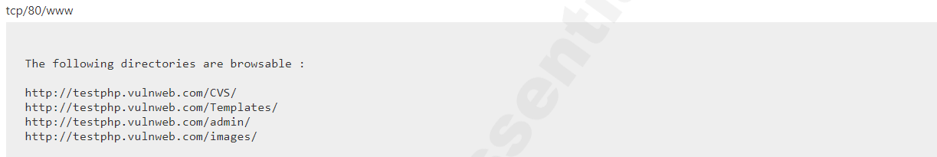
Vulnerability Detection Result:

Slide 44
16. CGI Generic Cookie Injection Scripting
Observation:
The remote web server is prone to cookie injection attacks.
The remote web server hosts at least one CGI script that fails to adequately sanitize request strings with malicious JavaScript.
By leveraging this issue, an attacker may be able to inject arbitrary cookies. Depending on the structure of the web application, it may be possible to launch a 'session fixation' attack using this mechanism.
Recommendation:
Restrict access to the vulnerable application. Contact the vendor for a patch or upgrade.

Slide 45
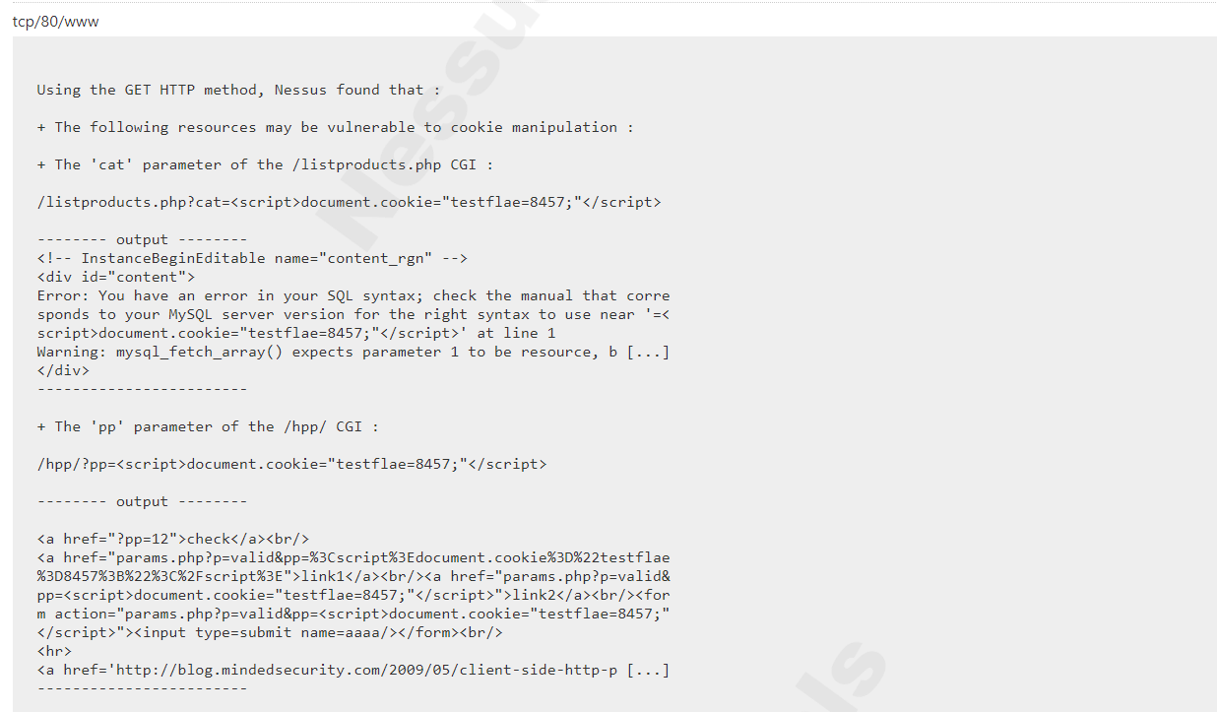
Vulnerability Detection Result:

Slide 46
17. CGI Generic HTML Injections (quick test)
Observation:
The remote web server may be prone to HTML injections.
The remote web server hosts CGI scripts that fail to adequately sanitize request strings with malicious JavaScript. By leveraging this issue, an attacker may be able to cause arbitrary HTML to be executed in a user's browser within the security context of the affected site.
The remote web server may be vulnerable to IFRAME injections or cross-site scripting attacks.
IFRAME injections allow 'virtual defacement' that might scare or anger gullible users. Such injections are sometimes implemented for 'phishing' attacks.
Recommendation:
Either restrict access to the vulnerable application or contact the vendor for an update.

Slide 47
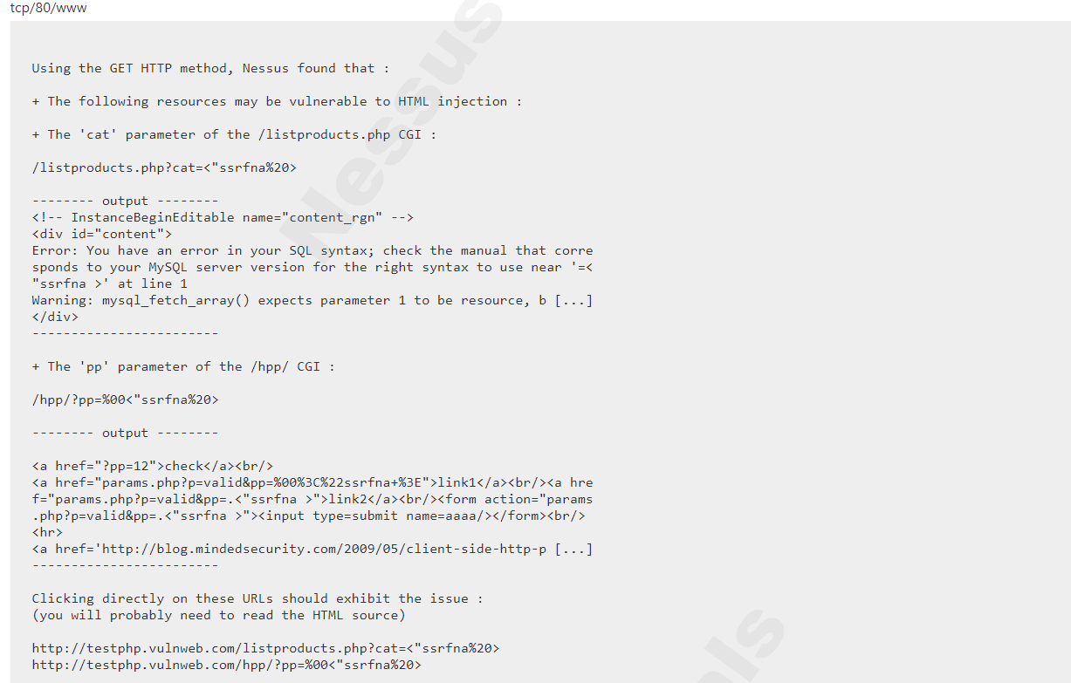
Vulnerability Detection Result:

Slide 48
18. CGI Generic XSS (quick test)
Observation:
The remote web server is prone to cross-site scripting attacks.
The remote web server hosts CGI scripts that fail to adequately sanitize request strings with malicious JavaScript. By leveraging this issue, an attacker may be able to cause arbitrary HTML and script code to be executed in a user's browser within the security context of the affected site.
These XSS are more likely to be both Reflected and Stored.
Recommendation:
Restrict access to the vulnerable application. Contact the vendor for a patch or upgrade to address any cross-site scripting vulnerabilities.

Slide 49
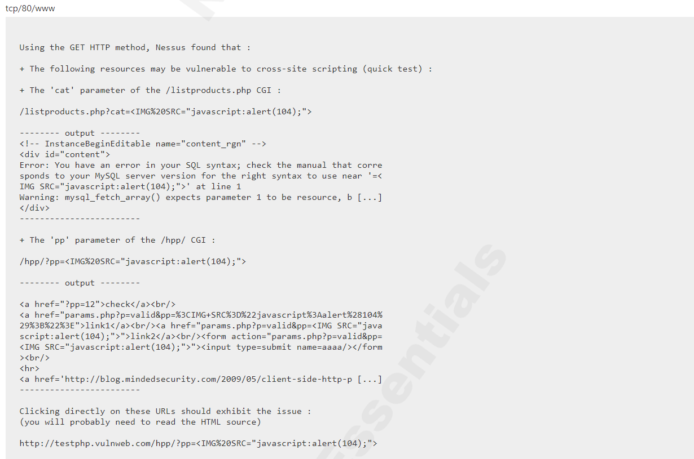
Vulnerability Detection Result:

Slide 50
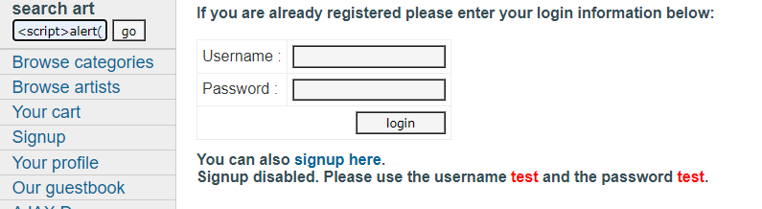
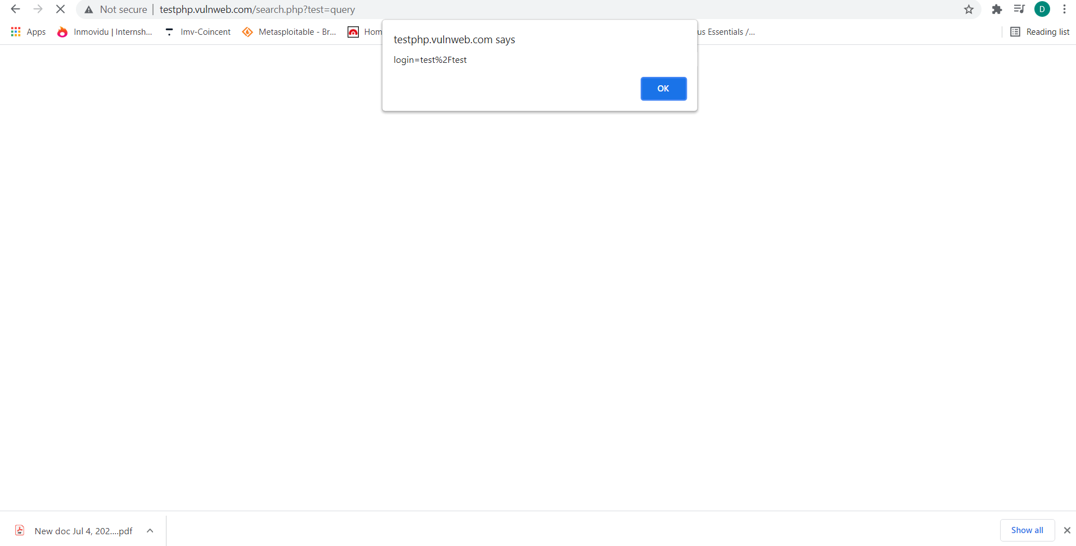
Vulnerability Detection Result: (Manual) Reflected XSS:

Slide 51
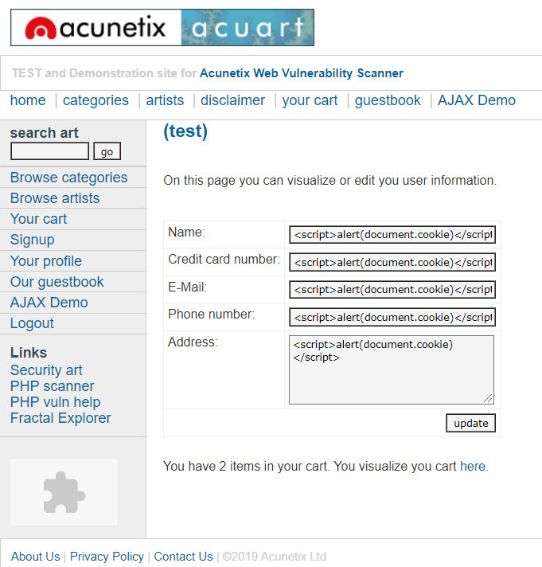
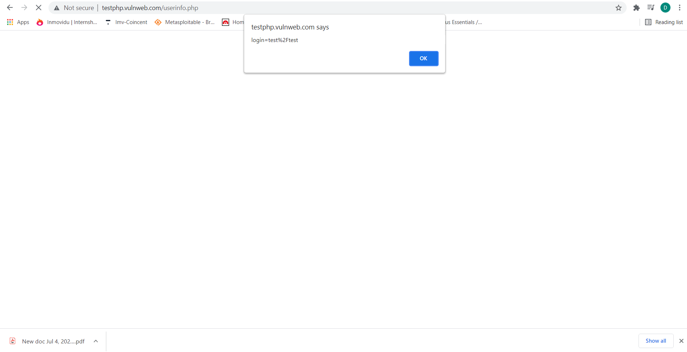
Stored XSS:

Slide 52
19. PHP < 5.2.10 Multiple Vulnerabilities
Observation:
The remote web server uses a version of PHP that is affected by multiple vulnerabilities.
According to its banner, the version of PHP installed on the remote host is older than 5.2.10. Such versions are reportedly affected by multiple vulnerabilities :
- Sufficient checks are not performed on fields reserved for offsets in function 'exif_read_data()'. Successful exploitation of this issue could result in a denial-of-service condition. (bug 48378)
- Provided 'safe_mode_exec_dir' is not set (not set by default), it may be possible to bypass 'safe_mode' restrictions by preceding a backslash in functions such as 'exec()', 'system()', 'shell_exec()', 'passthru()’ and 'popen()' on a system running PHP on Windows. (bug 45997)
Recommendation:
Upgrade to PHP version 5.2.10 or later.

Slide 53
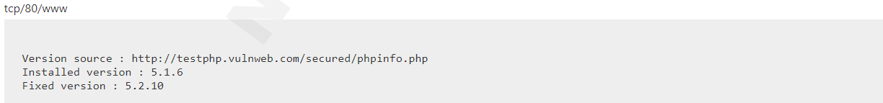
Vulnerability Detection Result:

Slide 54
20. PHP < 5.2.12 Multiple Vulnerabilities
Observation:
The remote web server uses a version of PHP that is affected by multiple flaws.
According to its banner, the version of PHP installed on the remote host is older than 5.2.12. Such versions may be affected by several security issues :
- It is possible to bypass the 'safe_mode' configuration setting using 'tempnam()'. (CVE-2009-3557)
- It is possible to bypass the 'open_basedir' configuration setting using 'posix_mkfifo()'. (CVE-2009-3558)
- Provided file uploading is enabled (it is by default), an attacker can upload files using a POST request with 'multipart/form-data' content even if the target script doesn't actually support file uploads per se. By supplying a large number (15,000+) of files, an attacker could cause the web server to stop responding while it processes the file list. (CVE-2009-4017)

Slide 55
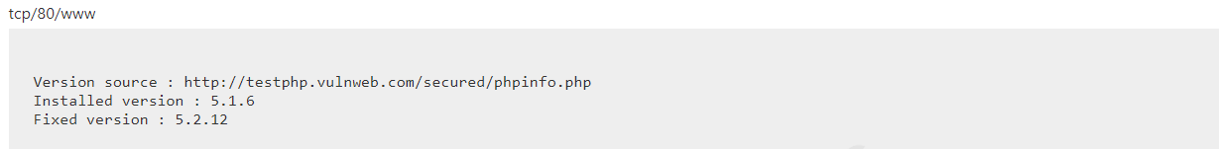
- Missing protection for '$_SESSION' from interrupt corruption and improved 'session.save_path' check. (CVE-2009-4143)
Insufficient input string validation in the 'htmlspecialchars()' function. (CVE-2009-4142)
Recommendation:
Upgrade to PHP version 5.2.12 or later.
Vulnerability Detection Result:

Slide 56
21. PHP < 5.2.4 Multiple Vulnerabilities
Observation:
The remote web server uses a version of PHP that is affected by multiple flaws.
According to its banner, the version of PHP installed on the remote host is older than 5.2.4. Such versions may be affected by various issues, including but not limited to several overflows.
Recommendation:
Upgrade to PHP version 5.2.4 or later.

Slide 57
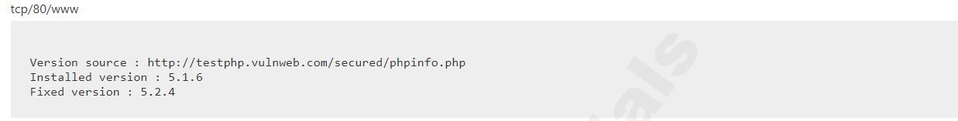
Vulnerability Detection Result:

Slide 58
22. PHP < 5.2.5 Multiple Vulnerabilities
Observation:
The remote web server uses a version of PHP that is affected by multiple flaws.
According to its banner, the version of PHP installed on the remote host is older than 5.2.5. Such versions may be affected by various issues, including but not limited to several overflows.
Recommendation:
Upgrade to PHP version 5.2.5 or later.

Slide 59

Vulnerability Detection Result:

Slide 60
23. PHP < 5.2.9 Multiple Vulnerabilities
Observation:
The remote web server uses a version of PHP that is affected by multiple flaws.
According to its banner, the version of PHP installed on the remote host is older than 5.2.9. Such versions may be affected by several security issues :
- Background color is not correctly validated with a non true color image in function 'imagerotate()'. (CVE-2008-5498)
- A denial-of-service condition can be triggered by trying to extract zip files that contain files with relative paths in file or directory names.
- Function 'explode()' is affected by an unspecified vulnerability.
- It may be possible to trigger a segfault by passing a specially crafted string to function 'json_decode()'.
- Function 'xml_error_string()' is affected by a flaw which results in messages being off by one.

Slide 61
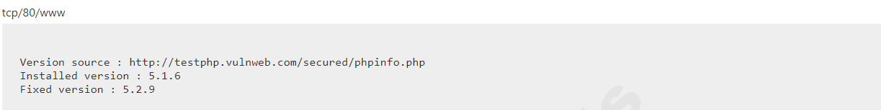
Recommendation: Upgrade to PHP version 5.2.9 or later. Vulnerability Detection Result:

Slide 62
24. PHP < 5.3.11 Multiple Vulnerabilities
Observation:
The remote web server uses a version of PHP that is affected by multiple flaws.
According to its banner, the version of PHP installed on the remote host is earlier than 5.3.11, and as such is potentially affected by multiple vulnerabilities :
- During the import of environment variables, temporary changes to the 'magic_quotes_gpc' directive are not handled properly. This can lower the difficulty for SQL injection attacks. (CVE-2012-0831)
- The '$_FILES' variable can be corrupted because the names of uploaded files are not properly validated.
(CVE-2012-1172)
- The 'open_basedir' directive is not properly handled by the functions 'readline_write_history' and 'readline_read_history'.
- The 'header()' function does not detect multi-line headers with a CR. (Bug #60227 / CVE-2011-1398)

Slide 63
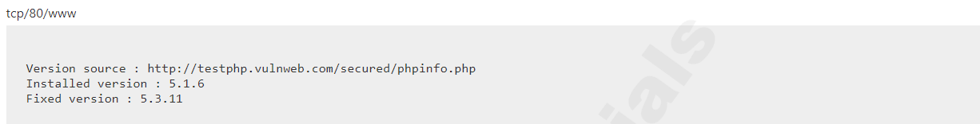
Recommendation: Upgrade to PHP version 5.3.11 or later. Vulnerability Detection Result:

Slide 64
25. PHP < 5.3.2/5.2.13 Multiple Vulnerabilities
Observation:
The remote web server uses a version of PHP that is affected by multiple flaws.
According to its banner, the version of PHP installed on the remote host is older than 5.3.2 / 5.2.13. Such versions may be affected by several security issues :
- Directory paths not ending with '/' may not be correctly validated inside 'tempnam()' in 'safe_mode' configuration.
- It may be possible to bypass the 'open_basedir'/ 'safe_mode' configuration restrictions due to an error in session extensions.
- An unspecified vulnerability affects the LCG entropy.

Slide 65
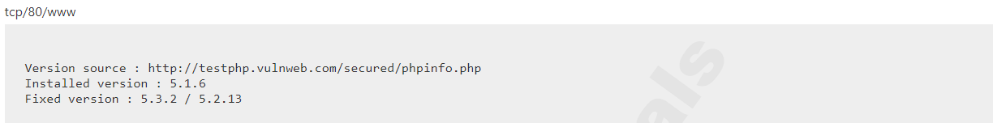
Recommendation: Upgrade to PHP version 5.3.2 / 5.2.13 or later. Vulnerability Detection Result:

Slide 66
26. PHP PHP_RSHUTDOWN_FUNCTION Security Bypass
Observation:
The remote web server uses a version of PHP that is potentially affected by a security bypass vulnerability.
According to its banner, the version of PHP 5.x installed on the remote host is 5.x prior to 5.3.11 or 5.4.x prior to 5.4.1 and thus, is potentially affected by a security bypass vulnerability.
An error exists related to the function 'PHP_RSHUTDOWN_FUNCTION' in the libxml extension and the 'stream_close' method that could allow a remote attacker to bypass 'open_basedir' protections and obtain sensitive information.
Recommendation:
Upgrade to PHP version 5.3.11 / 5.4.1 or later.

Slide 67
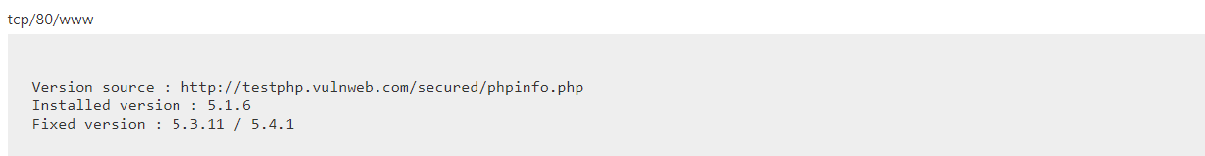
Vulnerability Detection Result:

Slide 68
27. No Security Policy Found For Passwords
Observation:
I observed (manually) that No password policy has been applied on this website. Users can set general passwords.
General passwords are easy to guess and are prone to hack by dictionary and brute-force attacks.
Recommendation:
Always have a password policy of minimum 8 characters which includes 1 special character, a capital letter, and 1 numeric value.

Slide 69
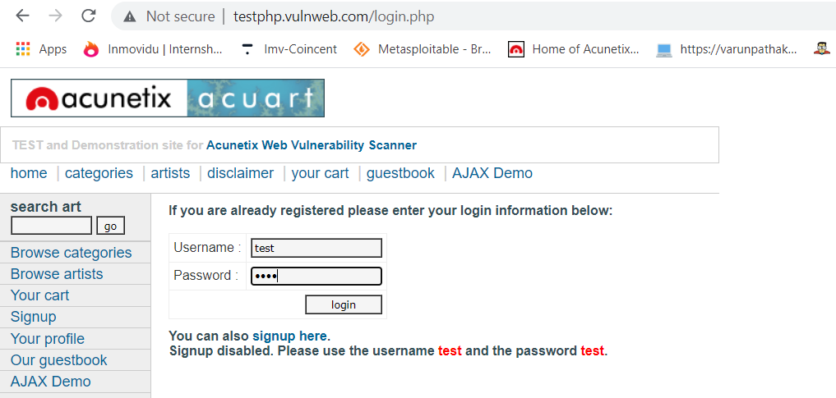
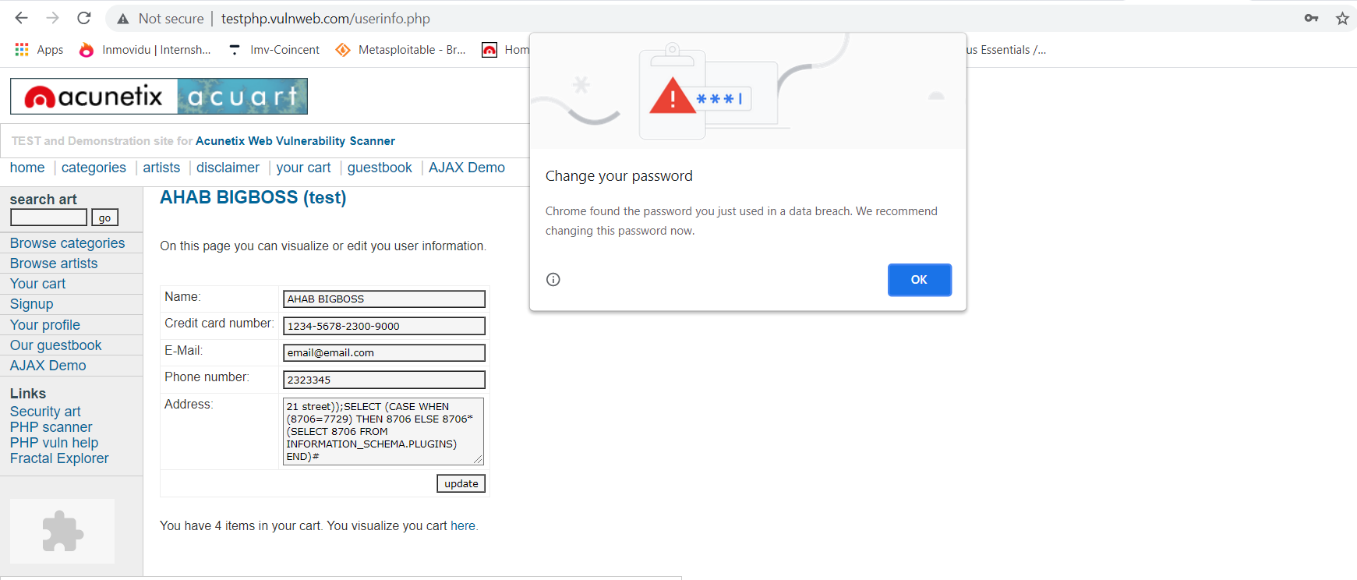
Vulnerability Detection Result:

Slide 70
28. Web Application Potentially Vulnerable to Clickjacking
Observation:
The remote web server may fail to mitigate a class of web application vulnerabilities.
The remote web server does not set an X-Frame-Options response header or a Content-Security-Policy 'frame-ancestors' response header in all content responses.
This could potentially expose the site to a clickjacking or UI redress attack, in which an attacker can trick a user into clicking an area of the vulnerable page that is different than what the user perceives the page to be. This can result in a user performing fraudulent or malicious transactions.
Recommendation:
Return the X-Frame-Options or Content-Security-Policy (with the 'frame-ancestors' directive) HTTP header with the page's response.
This prevents the page's content from being rendered by another site when using the frame or iframe HTML tags.

Slide 71
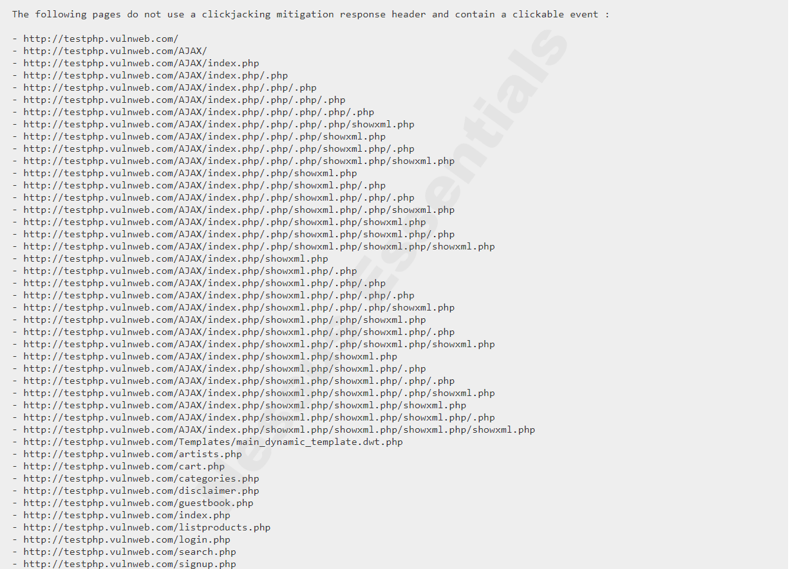
Vulnerability Detection Result:

Slide 72
29. Web Server info.php / phpinfo.php Detection
Observation:
The remote web server contains a PHP script that is prone to an information disclosure attack.
Many PHP installation tutorials instruct the user to create a PHP file that calls the PHP function 'phpinfo()' for debugging purposes. Various PHP applications may also include such a file. By accessing such a file, a remote attacker can discover a large amount of information about the remote web server, including :
- The username of the user who installed PHP and if they are a SUDO user.
- The IP address of the host.
- The version of the operating system.
- The web server version.
- The root directory of the web server.
- Configuration information about the remote PHP installation.

Slide 73
Recommendation: Remove the affected file(s). Vulnerability Detection Result:

Slide 74
30. Web Server Transmits Cleartext Credentials
Observation:
The remote web server might transmit credentials in cleartext.
The remote web server contains several HTML form fields containing an input of type 'password' which transmit their information to a remote web server in cleartext.
An attacker eavesdropping the traffic between web browser and server may obtain logins and passwords of valid users.
Recommendation:
Make sure that every sensitive form transmits content over HTTPS.

Slide 75
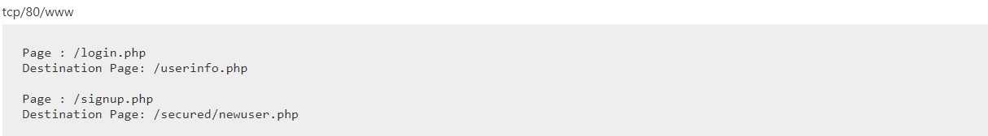
Vulnerability Detection Result:

Slide 76
2. Vulnerability Assessment on Windows 10 (Host Machine)

Slide 77
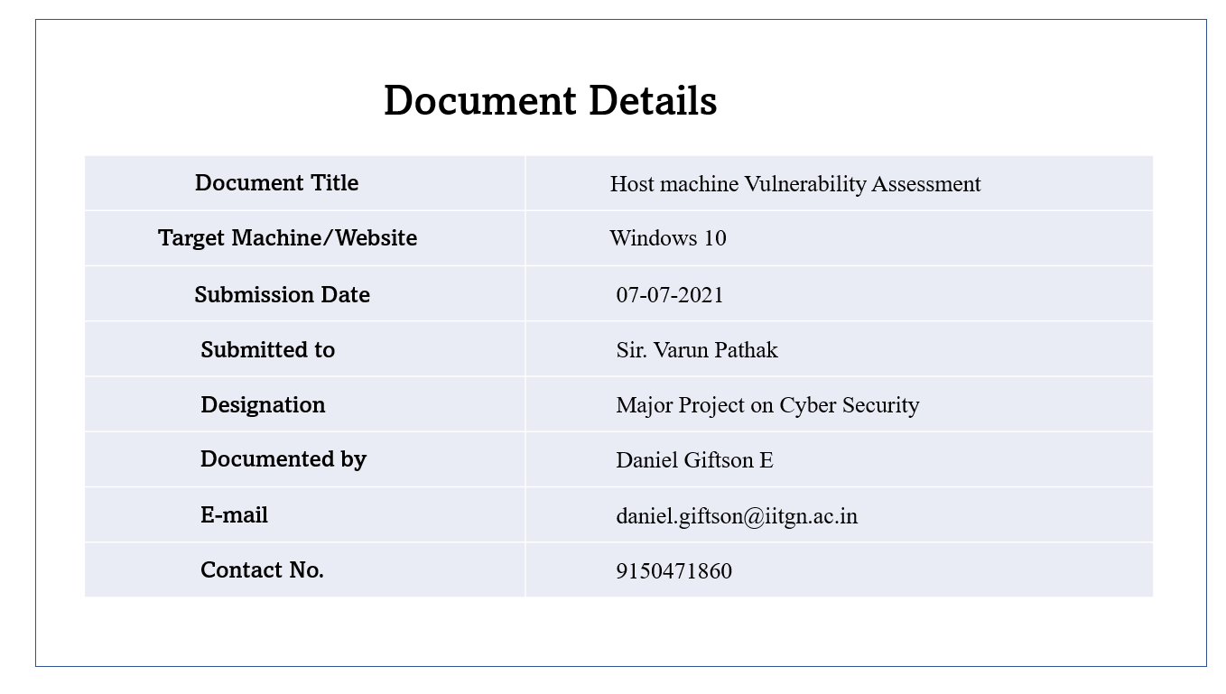

Slide 78
High – Level Summary of Testing Overview of the Vulnerability Assessment

Slide 79
Vulnerability Assessment - Overview
Background:
I performed a black-box vulnerability assessment, using Nessus advanced automatic scanner as well as found out vulnerabilities manually.
I ranked the vulnerabilities according to the threat level on the Severity Base of CVSS v3.0.
I have also recommended solutions for the vulnerabilities identified.
I, therefore, have communicated all the results and outputs through this report.
Result:
During assessment, I found out very few system related vulnerabilities are present in my host machine of Windows 10.
The threat level therefore is very minimal.

Slide 80
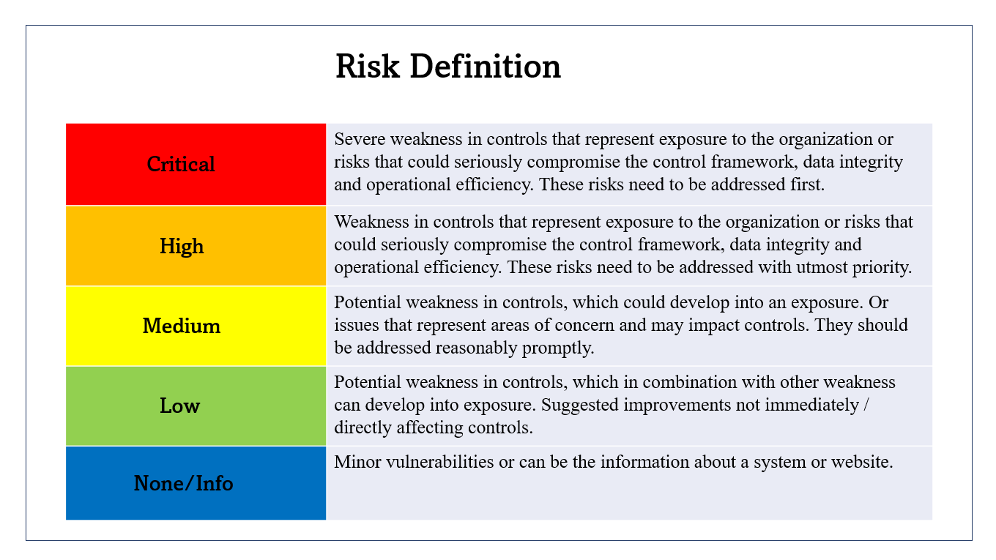

Slide 81
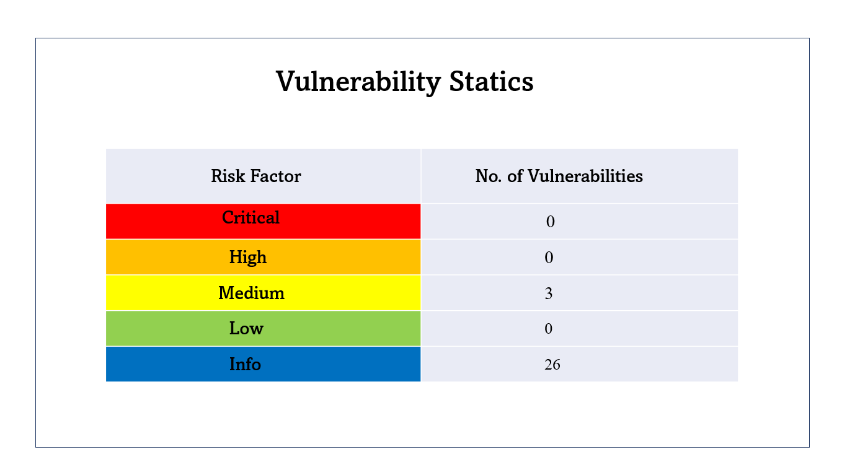

Slide 82
1. SMB Signing not required
Observation:
Signing is not required on the remote SMB server.
Signing is not required on the remote SMB server. An unauthenticated, remote attacker can exploit this to conduct man-in-the-middle attacks against the SMB server.
Recommendation:
Enforce message signing in the host's configuration. On Windows, this is found in the policy setting 'Microsoft network server: Digitally sign communications (always)'. On Samba, the setting is called 'server signing'.

Slide 83
2. No Security Policy Found For Passwords
Observation:
I observed that No password policy has been applied on the server, Users can set general passwords.
General passwords are easy to guess and are prone to hack by using dictionary or brute-force attacks.
Recommendation:
Always have a password policy of minimum 8 characters which includes 1 special character, a capital letter, and 1 numeric value.

Slide 84
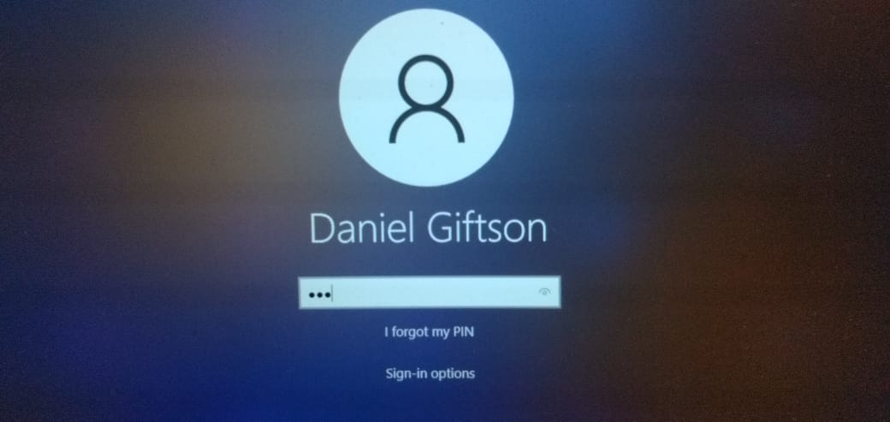
Vulnerability Detection Result:
3-digit login passwords used by the user which is not ideal.

Slide 85
3. Password aging limits not found
Observation:
During the assessment, I observed that the password is set to not expire for the normal user account.
Password aging limit enforce password changing on a regular basis.
Lack of password expiry may allow a compromised user account to be misused for longer duration without being tested.
Recommendation:
Enforce password change at least every 30 days for administrative users and 60 days for normal
users.

Slide 86
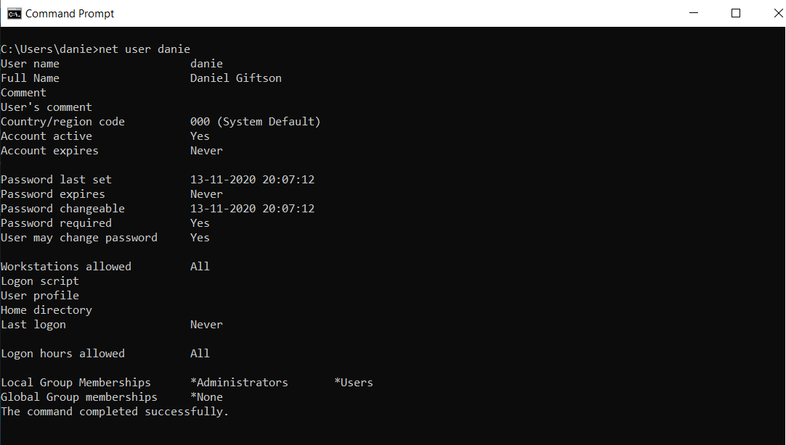
Vulnerability Detection Result:

Slide 87
3. Find the password of username hidden in www.varunpathak.in/m1ss10n.zip

Slide 88
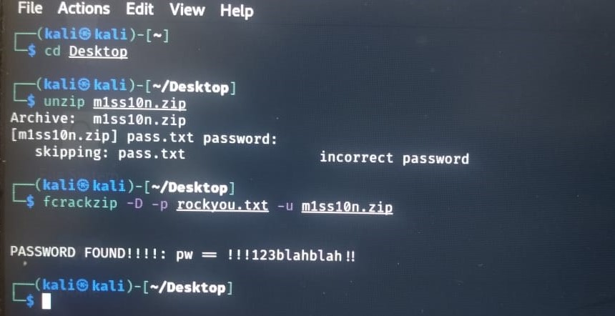
Password of the m1ss10n.zip file is : !!!123blahblah!!

Slide 89
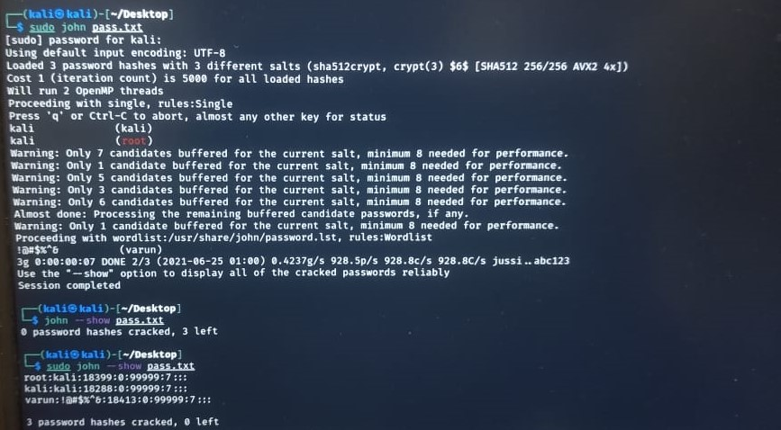
3 password hashes cracked:
root : kali
kali : kali
varun : !@#$%^&

Slide 90
4. Find a way to hide a video behind the image and run it.

Slide 91
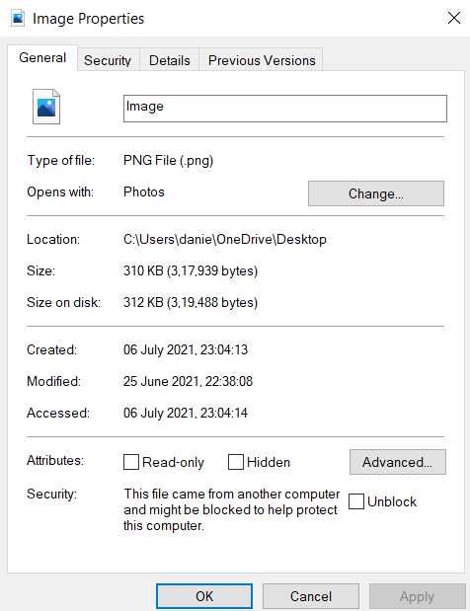
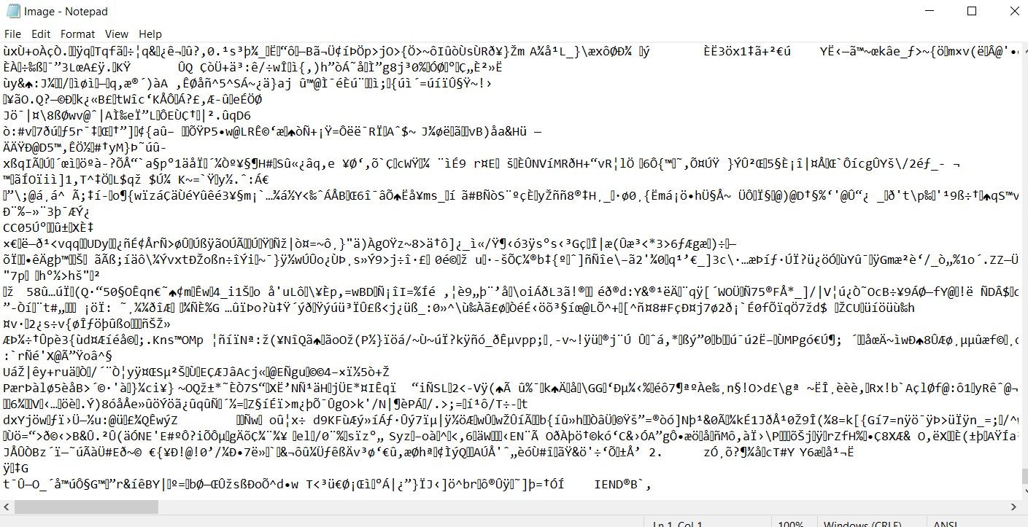

This shows the video compressed in a .rar file and an .png file of an image.
Properties and data in the notepad of the Image.png file respectively.

Slide 92
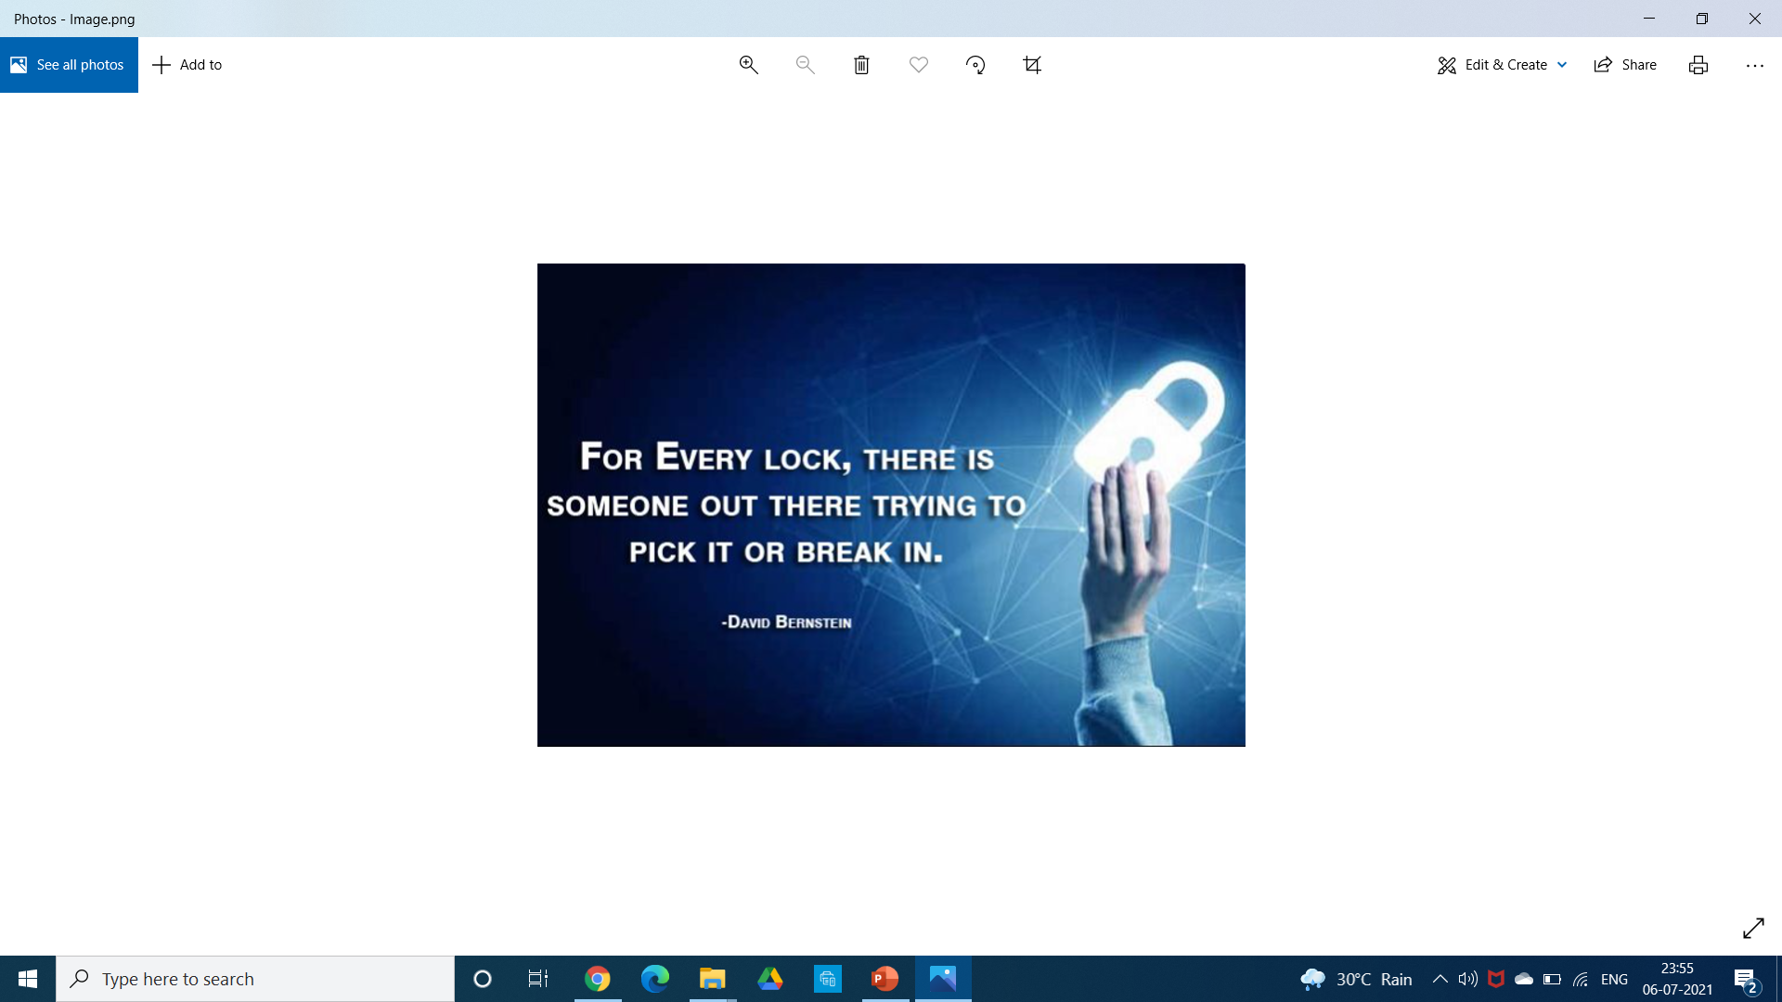

Slide 93
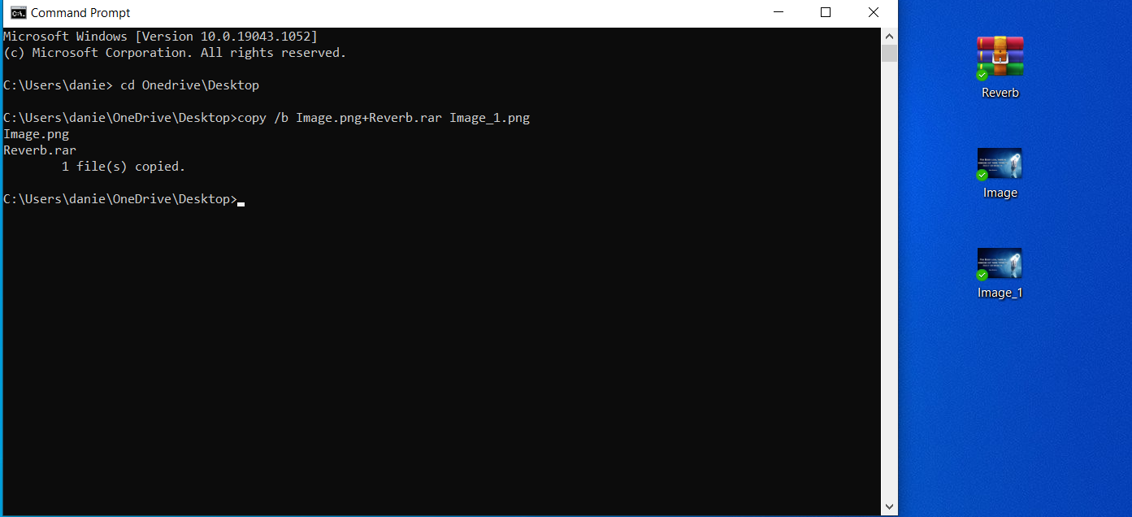
Hiding the .rar file containing the video behind the image and naming the png file as Image_1

Slide 94


Slide 95
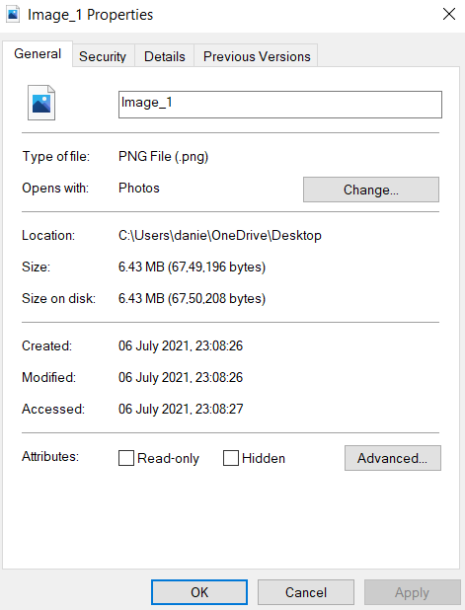

Properties and data of the Image_1.png file respectively.

Slide 96

Isolating the hidden .rar file(Containing the .mp4 file of the video) from the Image_1.png and naming it OutputReverb.rar.

Slide 97


Therefore, we can extract the .mp4 file and can run it.

Slide 98
THE END…..

